Slide 1

NAME : S Vignesh
NM ID : aut2241270001
PROJECT TITLE : Image Classification using CNN

Slide 2
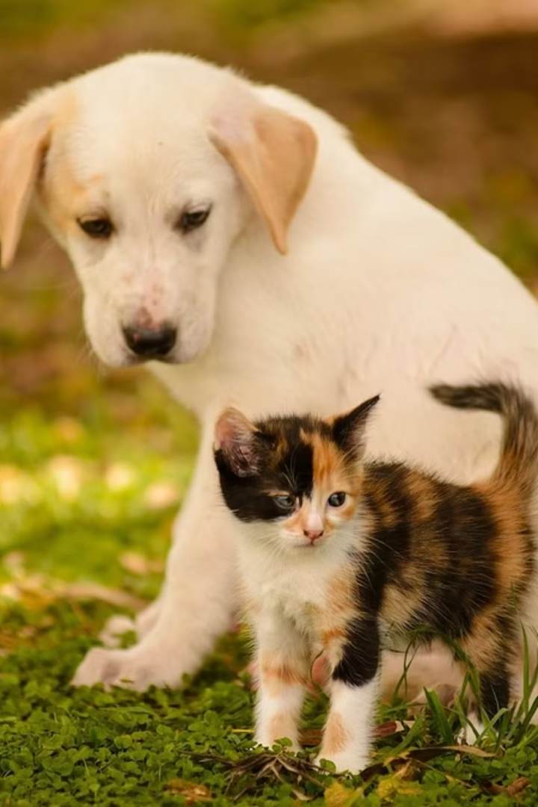
Overview of the Project: Cat vs. Dog Classification
This project aims to develop an image classification model that can accurately distinguish between images of cats and dogs. Using convolutional neural networks (CNN), we will train a deep learning model to recognize the unique visual features that distinguish these two popular pet species.

Slide 3
Agenda
Overview
Dataset Preparation
Introduction to the project, key objectives, and expected outcomes.
Data collection, cleaning, and preprocessing for the Cat vs. Dog image dataset.
Model Training
Evaluation and Deployment
Building and training the Convolutional Neural Network (CNN) model for image classification.
Testing the model's performance and planning for real-world deployment.

Slide 4

Problem statement
The project aims to build a Convolutional Neural Network (CNN) model that can accurately classify images as either a cat or a dog. This is a common computer vision task with many real-world applications, such as pet identification, wildlife monitoring, and security systems.

Slide 5
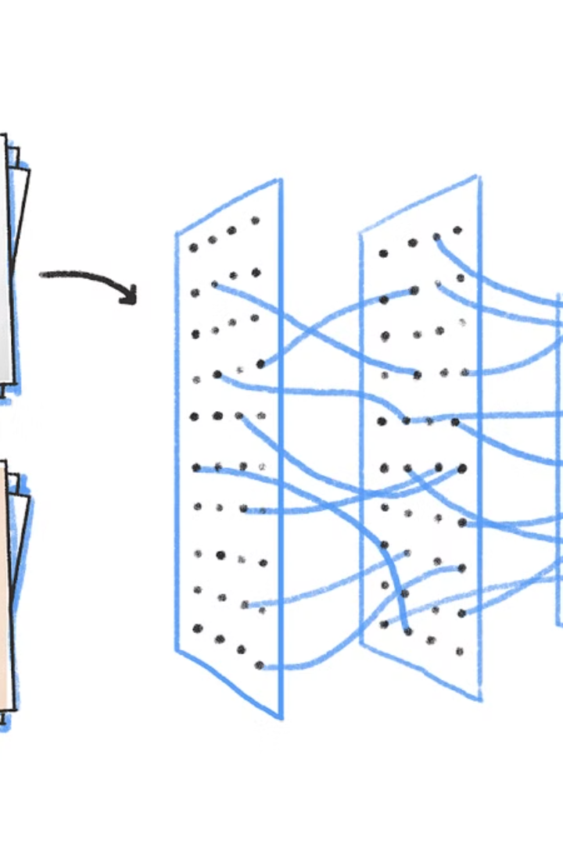
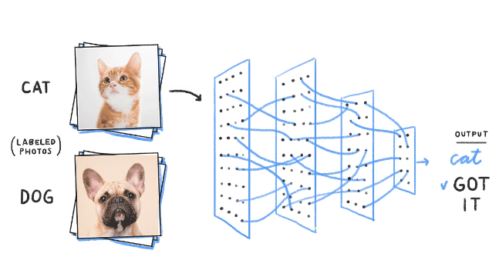
Convolutional Neural Networks (CNNs) for Image Classification
Convolutional Neural Networks (CNNs) are a powerful deep learning architecture well-suited for image classification tasks. CNNs leverage hierarchical feature extraction, with convolutional layers learning low-level visual features and deeper layers combining these into higher-level semantic concepts.
The structured, grid-like nature of image data makes CNNs particularly effective, allowing them to efficiently process and learn from visual inputs. This makes CNNs a preferred choice for a wide range of image-based applications, from object detection to medical diagnosis.

Slide 6
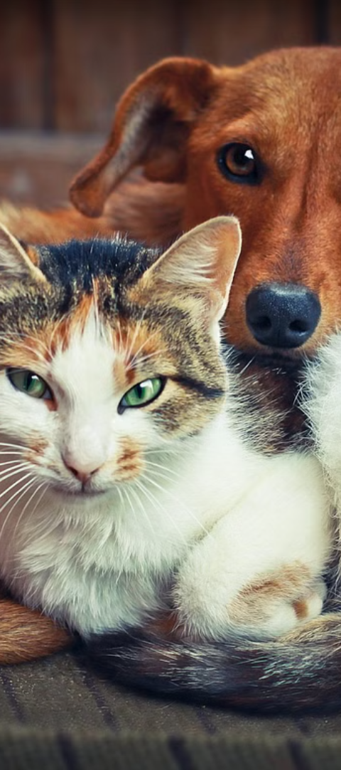
Dataset Preparation and Preprocessing
1
Data Collection
Gather a diverse dataset of cat and dog images from reputable online sources, ensuring balanced representation across breeds and settings.
2
Image Preprocessing
Resize all images to a consistent size, normalize pixel values, and apply data augmentation techniques to increase the dataset size and diversity.
3
Label Assignment
Carefully label each image as either "cat" or "dog" to enable supervised learning during the training process.

Slide 7
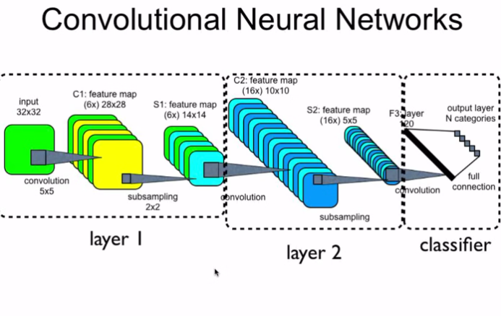
Model Training and Evaluation
To train the CNN model for cat and dog classification, we will split the dataset into training, validation, and test sets. The training set will be used to optimize the model's parameters, while the validation set will be used to monitor the model's performance and prevent overfitting.
The model will be evaluated using metrics such as accuracy, precision, recall, and F1-score to assess its performance on the test set. Techniques like data augmentation, transfer learning, and hyperparameter tuning will be explored to further improve the model's performance.

Slide 8



Who are the end users?
Businesses
Educators
Consumers
Businesses can use the image classification model to automatically categorize product images, improve search and recommendations, and streamline inventory management.
Educators can leverage the model to create interactive learning tools, analyze student-submitted images, and enhance visual literacy in the classroom.
Consumers can benefit from improved image search, visual shopping experiences, and personalized recommendations powered by the image classification model.

Slide 9
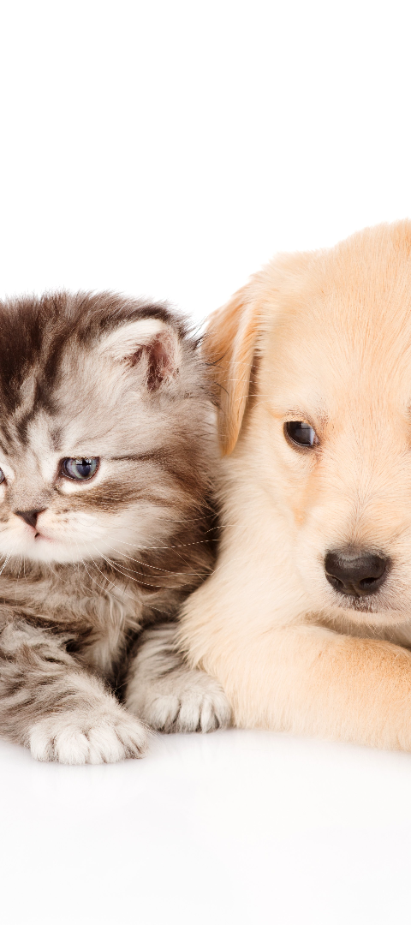
Wow in your Solution
Cutting-Edge Technology
Innovative User Experience
Utilize state-of-the-art Convolutional Neural Networks (CNNs) to achieve highly accurate cat and dog image classification with industry-leading performance.
Deliver a seamless and engaging user experience through an intuitive web interface, allowing users to easily upload and classify images with just a few clicks.
Impressive Visualization
Enhance the solution with visually stunning data visualizations, showcasing the model's performance and providing valuable insights to the users.

Slide 10
Your solution and its value proposition
Cutting-Edge CNN Model
Robust Performance
Efficient and Scalable
Practical Applications
Our solution leverages state-of-the-art convolutional neural network (CNN) architecture to accurately classify images of cats and dogs with high precision.
The model has been rigorously trained and tested on a diverse dataset, ensuring reliable and consistent classification results across a wide range of cat and dog breeds.
The CNN model is designed to be highly efficient, allowing for fast inference and easy integration into various applications and platforms.
This solution has a wide range of practical applications, such as pet identification, animal shelters, and social media, empowering users to quickly and accurately classify cat and dog images.

Slide 11
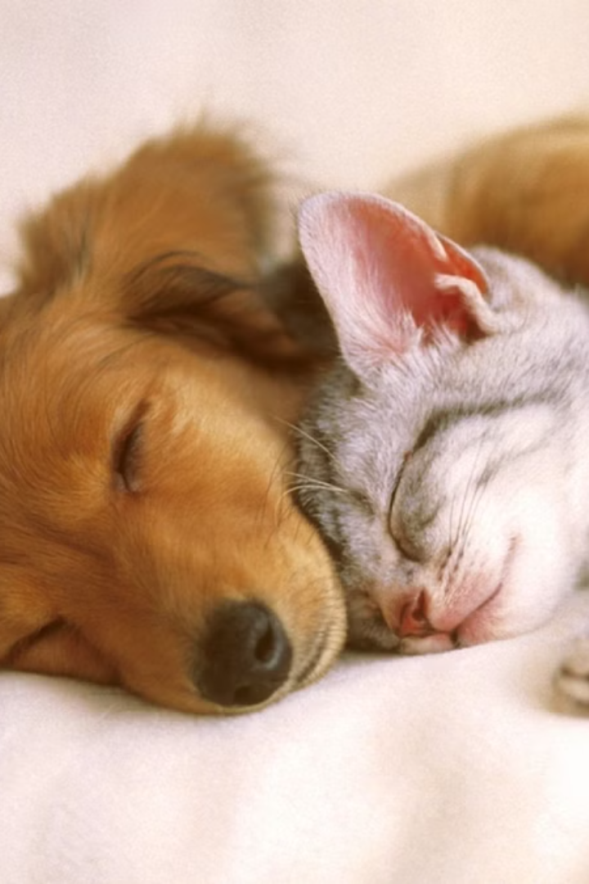
Conclusion and Future Improvements
In conclusion, the CNN-based cat vs. dog image classification solution has proven to be a powerful and accurate tool, empowering end-users to quickly and reliably identify pet species.
To further enhance the solution, future improvements could include expanding the dataset to include more diverse breeds, refining the model architecture, and integrating real-time video analysis for instant pet identification.
By continually iterating and improving the solution, we can deliver an even more robust and user-friendly platform that truly revolutionizes the way people interact with and understand their furry companions.

